Slide 1
Software Design and Architecture
Chain of Responsibility and Flyweight Patterns

Slide 2
Chain of Responsibility
Behavioral Patterns
observer
strategy
command
template
memento
state
Iterator
mediator
chain of responsibility
Creational Patterns
factory method
abstract factory
singleton
Structural Patterns
decorator
adapter
façade
composite
Bridge
Proxy

Slide 3
Problem
We want to design a system that gives more than one object a chance to handle a request

Slide 4
Example
Consider context-sensitive help for graphical user interface
Let’s say user clicks on a help button: Help request is handled by one of several objects, but which one depends on context and specificity of available help
Tight coupling problem: between the sender of a request and its receiver objects

Slide 5
The loose coupling solution
We want a loose coupling between the sender of a request and its receiver objects.

Slide 6
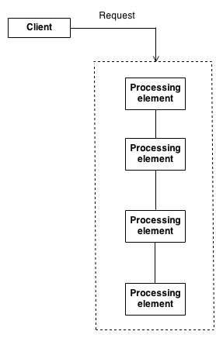
Encapsulate what varies?
Encapsulate the processing elements (receiver objects) inside a "pipeline" abstraction; and have clients "launch and leave" their requests at the entrance to the pipeline

Slide 7
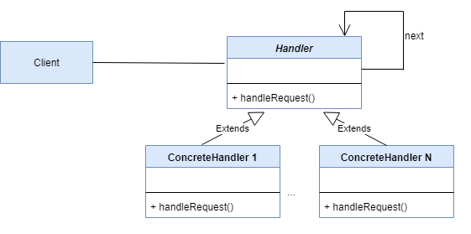
Chain of Responsibility Pattern
Client initiates the request to a ConcreteHandler object on the chain

Slide 8
Chain of Responsibility Pattern
Handler defines interface for handling requests; Can implement successor link

Slide 9
Chain of Responsibility Pattern
ConcreteHandler handles requests it is responsible for; otherwise forwards requests to successor

Slide 10
Example 1: Code implementing successor link
public class Test {
public static void main(String arg[]) {
Handler handler1 = new ConcreteHandler1();
Handler handler2 = new ConcreteHandler2();
Handler handler3 = new ConcreteHandler3();
Handler handler4 = new ConcreteHandler4();
handler1.setSuccessor(handler2);
handler2.setSuccessor(handler3);
handler3.setSuccessor(handler4);
handler1.handleRequest(); //launch and leave a request
}
}

Slide 11
Example 1: Code implementing successor link
public class Handler {
private Handler successor;
public void setSuccessor(Handler successor) {
this.successor = successor;
}
public Handler getSuccessor() {
return successor;
}
public void handleRequest() {
successor.handleRequest();
}
}

Slide 12
Example 1: Code implementing successor link
class ConcreteHandler1 extends Handler {
public void handleRequest() {
if ( /* We should handle this == */true) {
// Handle the request.
} else {
getSuccessor().handleRequest();
}
}
}

Slide 13
Example 2: Test
class TestChain
{
public static void main(String[] args) {
Chain chain = new Chain();
//Calling chain of responsibility
chain.process(new Number(90));
chain.process(new Number(-50));
chain.process(new Number(0));
chain.process(new Number(91));
}
}

Slide 14
Example 2:
abstract class Processor
{
private Processor nextProcessor;
public Processor(Processor nextProcessor){
this.nextProcessor = nextProcessor;
};
public void process(Number request){
if(nextProcessor != null)
nextProcessor.process(request);
};
}

Slide 15
Example 2:
class NegativeProcessor extends Processor
{
public NegativeProcessor(Processor nextProcessor){
super(nextProcessor);
}
public void process(Number request)
{
if (request.getNumber() < 0)
{
System.out.println("NegativeProcessor : " + request.getNumber());
}
else
{
super.process(request);
}
}
}

Slide 16
Example 2:
class ZeroProcessor extends Processor
{
public ZeroProcessor(Processor nextProcessor){
super(nextProcessor);
}
public void process(Number request)
{
if (request.getNumber() == 0)
{
System.out.println("ZeroProcessor : " + request.getNumber());
}
else
{
super.process(request);
}
}
}

Slide 17
Example 2:
class PositiveProcessor extends Processor
{
public PositiveProcessor(Processor nextProcessor){
super(nextProcessor);
}
public void process(Number request)
{
if (request.getNumber() > 0)
{
System.out.println("PositiveProcessor : " + request.getNumber());
}
else
{
super.process(request);
}
}
}

Slide 18
Example 2:
class Number//Request
{
private int number;
public Number(int number)
{
this.number = number;
}
public int getNumber()
{
return number;
}
}

Slide 19
Example 2:
public class Chain
{
Processor chain;
public Chain(){
buildChain();
}
private void buildChain(){
chain = new NegativeProcessor(new ZeroProcessor(new PositiveProcessor(null)));
}
public void process(Number request) {
chain.process(request);
}
}

Slide 20
Benefits:
Decouples the sender of the request and its receivers
Simplifies your object because it doesn’t have to know the chain’s structure and keep direct reference to its members,
Allows you to add or remove responsibilities dynamically by changing the members or the order of the chain

Slide 21
Drawbacks:
Execution of the request isn’t guaranteed; it may fall off the end of the chain if no object handles it (this can be an advantage or a disadvantage),
Can be hard to observe the runtime characteristics and debug

Slide 22
Flyweight
Behavioral Patterns
observer
strategy
command
template
memento
state
Iterator
mediator
chain of responsibility
Creational Patterns
factory method
abstract factory
singleton
Structural Patterns
decorator
adapter
façade
composite
bridge
proxy
flyweight

Slide 23

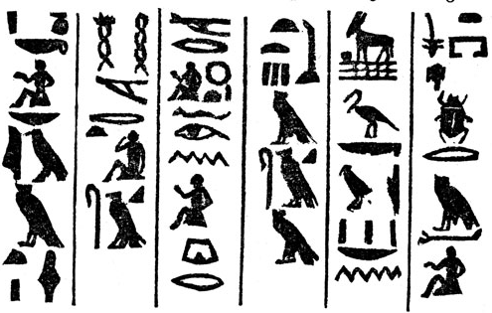
Problem
You are to display a sequence of symbols that represent some ancient text.
Issue: each symbol of the alphabet is very big not Unicode character.
Text
Alphabet

Slide 24
Problem
Conceptually, a text is a sequence of symbols.

Slide 25
Solution
However, you must implement it differently than a typical sequence for efficiency
Unique (extrinsic) state is stored outside of the
shared object
flyweight pool
One object instance holding shared (intrinsic) state

Slide 26
Example of Flyweight
We want to write an application to show 100,000 rectangles on the screen. Not creating new object just sharing what is existing.
Intrinsic data: color
Extrinsic data: size
Every time we creating a new rectangle; There has been a color that has already been used; We are not going to create a new rectangle object; We are going to share what has been already created with that similar color; The extrinsic state is going to be the thing different to these rectangles

Slide 27
Flyweight Pattern
USE SHARING TO SUPPORT LARGE NUMBERS OF FINE-GRAINED OBJECTS EFFICIENTLY.
One object instance holding shared (intrinsic) state
Unique (extrinsic) state is stored outside of the shared object
Encapsulate what varies?

Slide 28
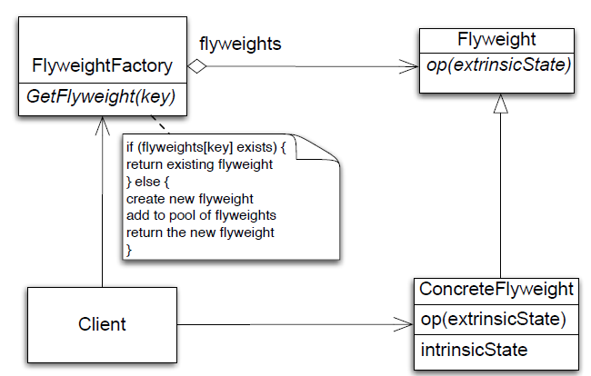
Class Diagram

Slide 29
Flyweight Participants
Flyweight
declares an interface through which flyweights can receive and act on extrinsic state
ConcreteFlyweight
implements Flyweight interface and adds storage for intrinsic state
FlyweightFactory
creates and manages flyweight objects
Client
maintains extrinsic state and stores references to flyweights

Slide 30
Flyweight Participants
Collaborations
Data that a flyweight needs to process must be classified as intrinsic or extrinsic
Intrinsic is stored with flyweight; Extrinsic is stored with client
Clients should not instantiate ConcreteFlyweights directly
Consequences
Storage savings is a tradeoff between total reduction in number of objects verses the amount of intrinsic state per flyweight and whether or not extrinsic state is computed or stored
greatest savings occur when extrinsic state is computed

Slide 31
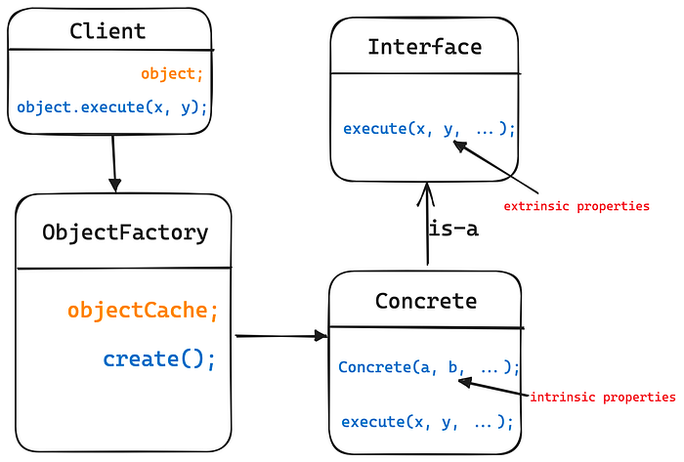
How to implement Flyweight Pattern?

Slide 32
}
//Flyweight
public interface Letter {
public void display(int row, int column);
}
//Concrete Flyweight
public class EditorCharacter implements Letter {
private char character;
private String fontType;
public EditorCharacter(char character, String fontType){
this.character = character;
this.fontType = fontType;
}
public char getCharacter() {
return this.character;
}
public String getFontType() {
return this.fontType;
}
@Override
public void display(int row, int column) {
System.out.println(String.valueOf(character)+" at row "+row+" column "+column);
}
}

Slide 33
//Flyweight Factory
public class LetterFactory {
//cache to store the letter for which object is already created or requested
private static Map<String, Letter> characterCache = new HashMap<>();
public static Letter createLetter(char characterValue, String fontType){
String key = fontType + "_" + characterValue;
//returns from the cache if available
if(characterCache.containsKey(key)) {
return characterCache.get(key);
} else {
EditorCharacter characterObject = new EditorCharacter(characterValue, fontType);
characterCache.put(key, characterObject);
return characterObject;
}
}
}

Slide 34
//Client
public class Client {
private static void addLetter(char characterValue, String fontType, int x, int y) {
Letter letter = LetterFactory.createLetter('l', "Arial");
letter.display(x, y);
}
public static void main(String[] args) {
/*
* Let' say my text is "Hello, this is Flyweight article!!"
*
*/
//to add letter l at 3 position
addLetter('l', "Arial", 0, 2);
//to add letter l at 4position
addLetter('l', "Arial", 0, 3);
//only one object for character 'l' of Arial type will be created
//regardless of how many times it is being used.
}
}

Slide 35
When to Use Flyweight
When all of the following are true
An application uses a large number of objects
Storage costs are high because of the sheer quantity of objects
Most object state can be made extrinsic
Many groups of objects may be replaced by relatively few shared objects once extrinsic state is removed
The application does not depend on object identity; Since flyweight objects may be shared, identity tests will return true for conceptually distinct objects

